Slide 1
What is Convolutional Neural Network?
Convolutional Neural Networks also known as CNNs or ConvNets, are a type of feed-forward artificial neural network whose connectivity structure is inspired by the organization of the animal visual cortex
https://www.superdatascience.com/blogs/the-ultimate-guide-to-convolutional-neural-networks-cnn

Slide 2
CNN
Small clusters of cells in the visual cortex are sensitive to certain areas of the visual field. Individual neuronal cells in the brain respond or fire only when certain orientations of edges are present.
Some neurons activate when shown vertical edges, while others fire when shown horizontal or diagonal edges.
A convolutional neural network is a type of artificial neural network used in deep learning to evaluate visual information.
These networks can handle a wide range of tasks involving images, sounds, texts, videos, and other media.
Professor Yann LeCunn of Bell Labs created the first successful convolution networks in the late 1990s.

Slide 3
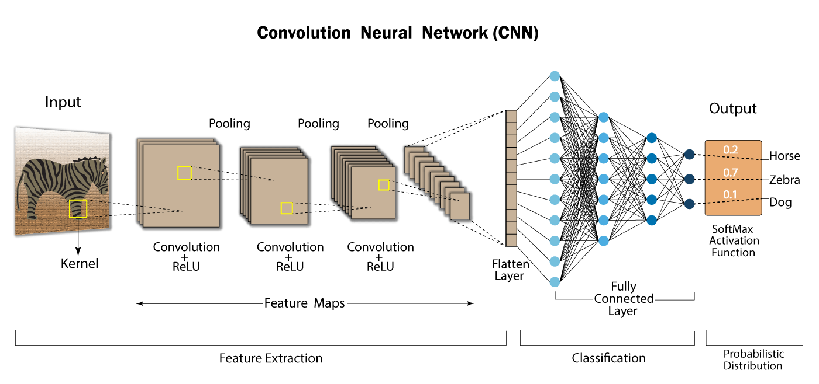

Slide 4
Convolutional Neural Networks (CNNs) have an input layer, an output layer, numerous hidden layers, and millions of parameters, allowing them to learn complicated objects and patterns.
It uses convolution and pooling processes to sub-sample the given input before applying an activation function, where all of them are hidden layers that are partially connected, with the completely connected layer at the end resulting in the output layer.
The output shape is similar to the size of the input image.

Slide 5
Process
Convolution is the process of combining two functions to produce the output of the other function.
The input image is convoluted with the application of filters in CNNs, resulting in a Feature map.
Filters are weights and biases that are randomly generated vectors in the network.
Instead of having individual weights and biases for each neuron, CNN uses the same weights and biases for all neurons.
Many filters can be created, each of which catches a different aspect from the input. Kernels are another name for filters.

Slide 6
Convolutional Layer
In convolutional neural networks, the major building elements are convolutional layers. This layer often contains input vectors, such as an image, filters, such as a feature detector, and output vectors, such as a feature map.
The image is abstracted to a feature map, also known as an activation map, after passing through a convolutional layer.

Slide 7
Feature Map = Input Image x Feature Detector
The input is convolved by convolutional layers, which then pass the output to the next layer.
This is analogous to a neuron’s response to a single stimulus in the visual cortex. Each convolutional neuron only processes data for the receptive field it is assigned to.
A convolution is a grouping function in mathematics.
Convolution occurs in CNNs when two matrices (rectangular arrays of numbers arranged in columns and rows) are combined to generate a third matrix.
In the convolutional layers of a CNN, these convolutions are used to filter input data and find information.

Slide 8
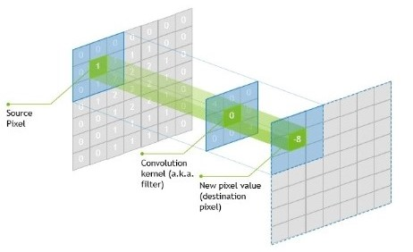
The kernel’s centre element is put above the source pixel.
After that, the source pixel is replaced with a weighted sum of itself and neighboring pixels.
Parameter sharing and local connectivity are two principles used in CNNs.
All neurons in a feature map share weights, which is known as parameter sharing.
Local connection refers to the idea of each neural being connected to only a part of
the input image (as opposed to a neural network in which all neurons are fully connected).
This reduces the number of parameters in the system and speeds up the calculation.

Slide 9
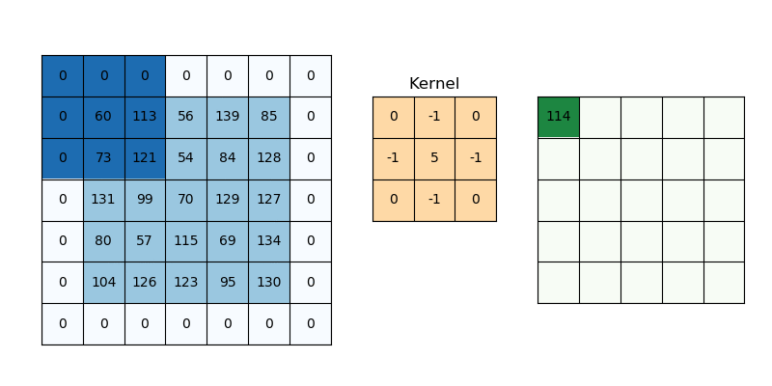
Padding and Stride
Padding and stride have an impact on how the convolution procedure is carried out. They can be used to increase or decrease the dimensions (height and width) of input/output vectors.
It is a term used in convolutional neural networks to describe how many pixels are added to an image when it is processed by the CNN kernel. If the padding in a CNN is set to zero, for example, every pixel value-added will have the value zero. If the zero padding is set to one, a one-pixel border with a pixel value of zero will be added to the image.

Slide 10
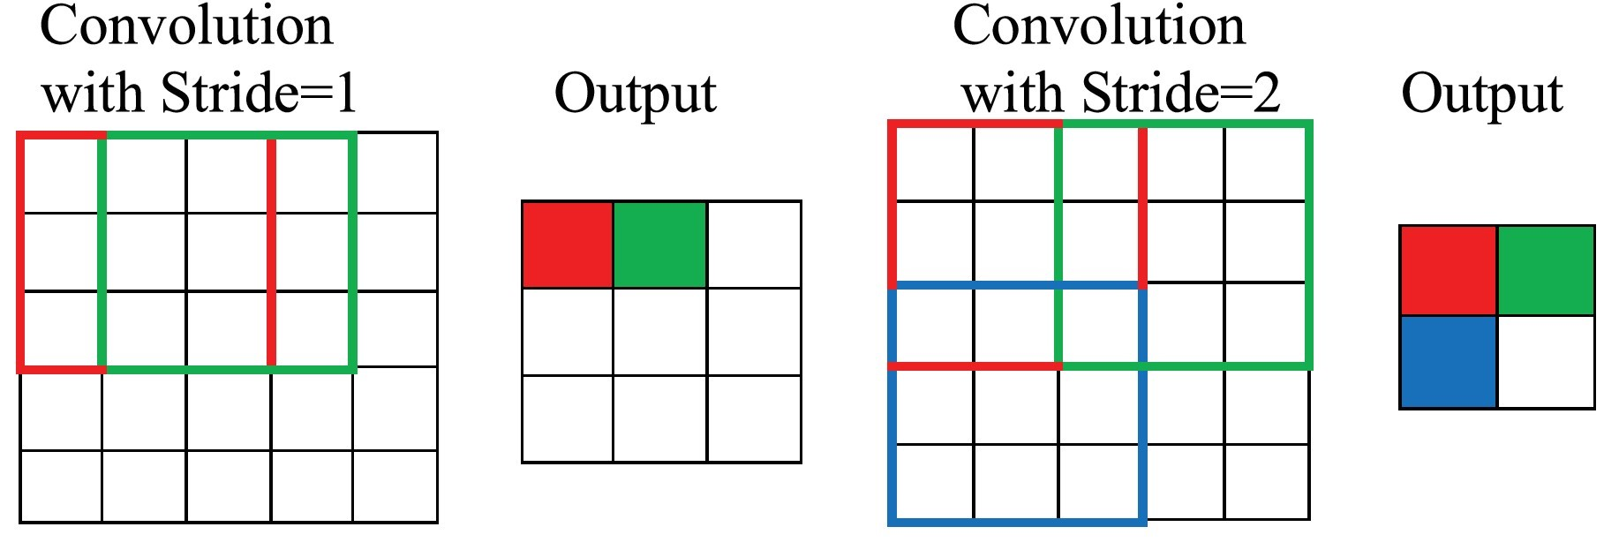
Padding
Padding works by increasing the processing region of a convolutional neural network.
The kernel is a neural network filter that moves through a picture, scanning each pixel and turning the data into a smaller or bigger format.
Padding is added to the image frame to aid the kernel in processing the image by providing more room for the kernel to cover the image. Adding padding to a CNN-processed image provides for more accurate image analysis.

Slide 11
Stride
Stride determines how the filter convolves over the input matrix, i.e. how many pixels shift. When stride is set to 1, the filter moves across one pixel at a time, and when the stride is set to 2, the filter moves across two pixels at a time. The smaller the stride value, the smaller the output, and vice versa.

Slide 12
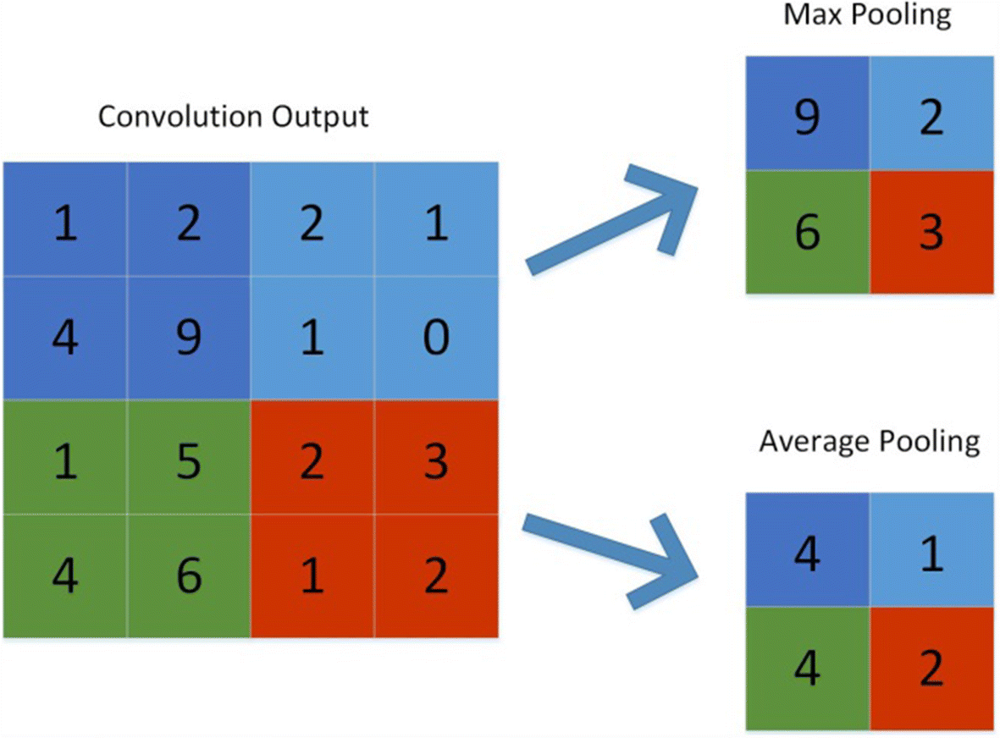
Pooling
Its purpose is to gradually shrink the representation’s spatial size to reduce the number of parameters and computations in the network. The pooling layer treats each feature map separately.

Slide 13
The following are some methods for pooling:
Max-pooling: It chooses the most significant element from the feature map. The feature map’s significant features are stored in the resulting max-pooled layer. It is the most popular method since it produces the best outcomes.
Average pooling: It entails calculating the average for each region of the feature map.
Pooling gradually reduces the spatial dimension of the representation to reduce the number of parameters and computations in the network, as well as to prevent overfitting. If there is no pooling, the output has the same resolution as the input.

Slide 14
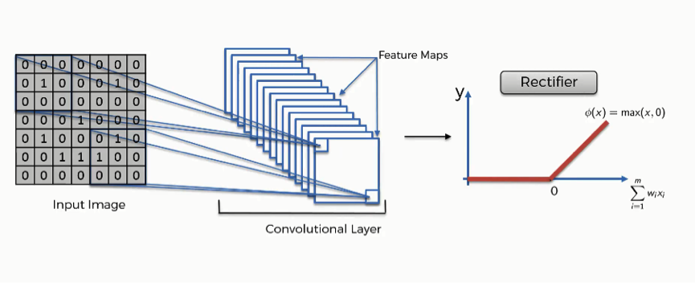
ReLU
The rectified linear activation function, or ReLU for short, is a piecewise linear function that, if the input is positive, outputs the input directly; else, it outputs zero. Because a model that utilizes it is quicker to train and generally produces higher performance, it has become the default activation function for many types of neural networks.

Slide 15
At the end of CNN, there is a Fully connected layer of neurons. As in conventional Neural Networks, neurons in a fully connected layer have full connections to all activations in the previous layer and work similarly.
After training, the feature vector from the fully connected layer is used to classify images into distinct categories.
Every activation unit in the next layer is coupled to all of the inputs from this layer.
Overfitting occurs because all of the parameters are occupied in the fully-connected layer.
Overfitting can be reduced using a variety of strategies, including dropout.

Slide 16
Soft-max is an activation layer that is typically applied to the network’s last layer, which serves as a classifier. This layer is responsible for categorizing provided input into distinct types. A network’s non-normalized output is mapped to a probability distribution using the softmax function.

Slide 17
from tensorflow.keras.models import Sequential
from tensorflow.keras.layers import Conv2D, MaxPooling2D, Flatten, Dense
# Load and pre-process data
# ...
# Define the CNN model
model = Sequential()
# Convolutional layer with 32 filters and kernel size 3x3
model.add(Conv2D(32, (3, 3), activation="relu", input_shape=(image_height, image_width, channels)))

Slide 18
# Max pooling layer with pool size 2x2
model.add(MaxPooling2D(pool_size=(2, 2)))
# Add another convolutional layer with 64 filters and kernel size 3x3
model.add(Conv2D(64, (3, 3), activation="relu"))
# Max pooling again
model.add(MaxPooling2D(pool_size=(2, 2)))
# Flatten extracted features
model.add(Flatten())

Slide 19
# Dense layer with 128 neurons
model.add(Dense(128, activation="relu"))
# Output layer with 10 neurons for 10 classes
model.add(Dense(10, activation="softmax"))
# Compile the model
model.compile(loss="categorical_crossentropy", optimizer="adam", metrics=["accuracy"])
# Train the model
model.fit(train_images, train_labels, epochs=10, validation_data=(val_images, val_labels))

Slide 20
# Evaluate model performance on test data
loss, accuracy = model.evaluate(test_images, test_labels)
print("Test loss:", loss)
print("Test accuracy:", accuracy)

Slide 21
What are recurrent neural networks?
A recurrent neural network (RNN) is a type of artificial neural network which uses sequential data or time series data.
These deep learning algorithms are commonly used for ordinal or temporal problems, such as language translation, natural language processing (nlp), speech recognition, and image captioning; they are incorporated into popular applications such as Siri, voice search, and Google Translate.
Like feedforward and convolutional neural networks (CNNs), recurrent neural networks utilize training data to learn.

Slide 22
RNN…
A single-time step of the input is provided to the network.
Then calculate its current state using a set of current input and the previous state.
The current ht becomes ht-1 for the next time step.
One can go as many time steps according to the problem and join the information from all the previous states.
Once all the time steps are completed the final current state is used to calculate the output.
The output is then compared to the actual output i.e the target output and the error is generated.
The error is then back-propagated to the network to update the weights and hence the network (RNN) is trained using Backpropagation through time.

Slide 23
They are distinguished by their “memory” as they take information from prior inputs to influence the current input and output.
While traditional deep neural networks assume that inputs and outputs are independent of each other, the output of recurrent neural networks depend on the prior elements within the sequence.
While future events would also be helpful in determining the output of a given sequence, unidirectional recurrent neural networks cannot account for these events in their predictions.

Slide 24
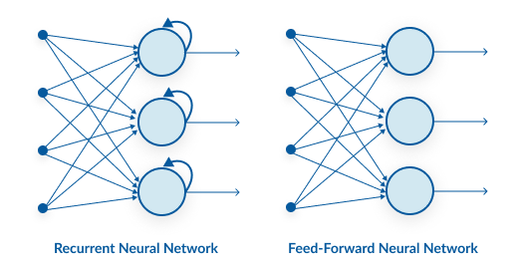
Feed-forward neural networks are poor predictions of what will happen next because they have no memory of the
information they receive. Because it simply analyses the current input, a feed-forward network has no idea of temporal
order. Apart from its training, it has no memory of what transpired in the past.
The information is in an RNN cycle via a loop. Before making a judgment, it evaluates the current input as well as what
it has learned from past inputs. A recurrent neural network, on the other hand, may recall due to internal memory.
It produces output, copies it, and then returns it to the network.

Slide 25
How does Recurrent Neural Networks work?

Slide 26
Gif file ….
The input layer x receives and processes the neural network’s input before passing it on to the middle layer.
Multiple hidden layers can be found in the middle layer h, each with its own activation functions, weights, and biases. You can utilize a recurrent neural network if the various parameters of different hidden layers are not impacted by the preceding layer, i.e. There is no memory in the neural network.
The different activation functions, weights, and biases will be standardized by the Recurrent Neural Network, ensuring that each hidden layer has the same characteristics. Rather than constructing numerous hidden layers, it will create only one and loop over it as many times as necessary.

Slide 27
Another distinguishing characteristic of recurrent networks is that they share parameters across each layer of the network.
While feedforward networks have different weights across each node, recurrent neural networks share the same weight parameter within each layer of the network.
That said, these weights are still adjusted in the through the processes of backpropagation and gradient descent to facilitate reinforcement learning.

Slide 28
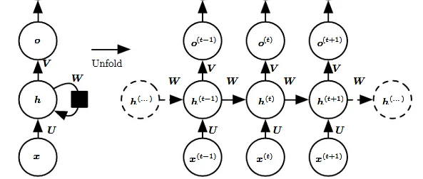

Slide 29
The left side of the above diagram shows a notation of an RNN and on the right side an RNN being unrolled (or unfolded) into a full network. By unrolling we mean that we write out the network for the complete sequence.
For example, if the sequence we care about is a sentence of 3 words, the network would be unrolled into a 3-layer neural network, one layer for each word.

Slide 30
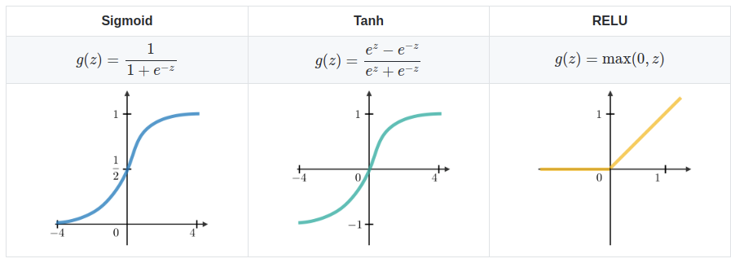
Common Activation Functions

Slide 31
Understanding of RNN
Input: x(t)​ is taken as the input to the network at time step t. For example, x1,could be a one-hot vector corresponding to a word of a sentence.
Hidden state: h(t)​ represents a hidden state at time t and acts as “memory” of the network. h(t)​ is calculated based on the current input and the previous time step’s hidden state:
h(t)​ = f(U x(t)​ + W h(t−1)​). The function f is taken to be a non-linear transformation such as tanh, ReLU.
Weights: The RNN has input to hidden connections parameterized by a weight matrix U, hidden-to-hidden recurrent connections parameterized by a weight matrix W, and hidden-to-output connections parameterized by a weight matrix V and all these weights (U,V,W) are shared across time.
Output: o(t)​ illustrates the output of the network. In the figure I just put an arrow after o(t) which is also often subjected to non-linearity, especially when the network contains further layers downstream.

Slide 32
Forward Pass
The ﬁgure does not specify the choice of activation function for the hidden units. Before we proceed we make few assumptions:
1) we assume the hyperbolic tangent activation function for hidden layer.
2) We assume that the output is discrete, as if the RNN is used to predict words or characters.
A natural way to represent discrete variables is to regard the output o as giving the un-normalized log probabilities of each possible value of the discrete variable.
We can then apply the softmax operation as a post-processing step to obtain a vector ŷ of normalized probabilities over the output.

Slide 33
Backward Pass
The gradient computation involves performing a forward propagation pass moving left to right through the graph shown above followed by a backward propagation pass moving right to left through the graph.
The runtime is O(τ) and cannot be reduced by parallelization because the forward propagation graph is inherently sequential; each time step may be computed only after the previous one.
States computed in the forward pass must be stored until they are reused during the backward pass, so the memory cost is also O(τ).
The back-propagation algorithm applied to the unrolled graph with O(τ) cost is called back-propagation through time (BPTT).
Because the parameters are shared by all time steps in the network, the gradient at each output depends not only on the calculations of the current time step, but also the previous time steps.

Slide 34
Types of RNN
One To One: There is only one pair here. A one-to-one architecture is used in traditional neural networks.
One To Many: A single input in a one-to-many network might result in numerous outputs. One too many networks are used in the production of music, for example.
Many To One: In this scenario, a single output is produced by combining many inputs from distinct time steps. Sentiment analysis and emotion identification use such networks, in which the class label is determined by a sequence of words.
Many To Many: For many to many, there are numerous options. Two inputs yield three outputs. Machine translation systems, such as English to French or vice versa translation systems, use many to many networks.

Slide 35
Implementation
General steps to follow:
Initialize weight matrices U, V, W from random distribution and bias b, c with zeros
Forward propagation to compute predictions
Compute the loss
Back-propagation to compute gradients
Update weights based on gradients
Repeat steps 2–5

Slide 36
Advantages and disadvantages of RNN
Advantages of RNNs:
Handle sequential data effectively, including text, speech, and time series.
Process inputs of any length, unlike feedforward neural networks.
Share weights across time steps, enhancing training efficiency.
Disadvantages of RNNs:
Prone to vanishing and exploding gradient problems, hindering learning.
Training can be challenging, especially for long sequences.
Computationally slower than other neural network architectures.
Recurrent Neural Network Vs Feedforwar

Slide 37
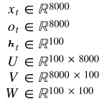
Step 1: Initialize
To start with the implementation of the basic RNN cell, we first define the dimensions of the various parameters U,V,W,b,c.
Dimensions:Let’s assume we pick a vocabulary size vocab_size= 8000 and a hidden layer size hidden_size=100. Then we have:
Vocabulary size can be the number of unique chars
for a char based model or number of unique words
for a word based model.

Slide 38
https://statso.io/next-word-prediction-case-study/
https://www.geeksforgeeks.org/next-word-prediction-with-deep-learning-in-nlp/

